Slide 1
Gender gap on Wikipedia (and GitHub)
A report on developments and the status quo
Eva Jobst (51824341)
Mohammad Zandpour (01425603)

Slide 2
Discrimination in the tech industry
GitHub: 14 million users
Pull-request of females more often rejected
Why is that?

Slide 3
Discrimination in the tech industry
Wikipedia: largest encyclopedia of mankind
Most editors are male
Acceptance rating on articles about females is low

Slide 4
Implications?
Missing information leads to lack of content variety
Lack of content variety leads to bias
Bias leads to discrimination

Slide 5
Example: assistive devices
Home assistance: Alexa, Google Assistant, etc.
Apps: Siri, Cortana, etc.
Google search

Slide 6
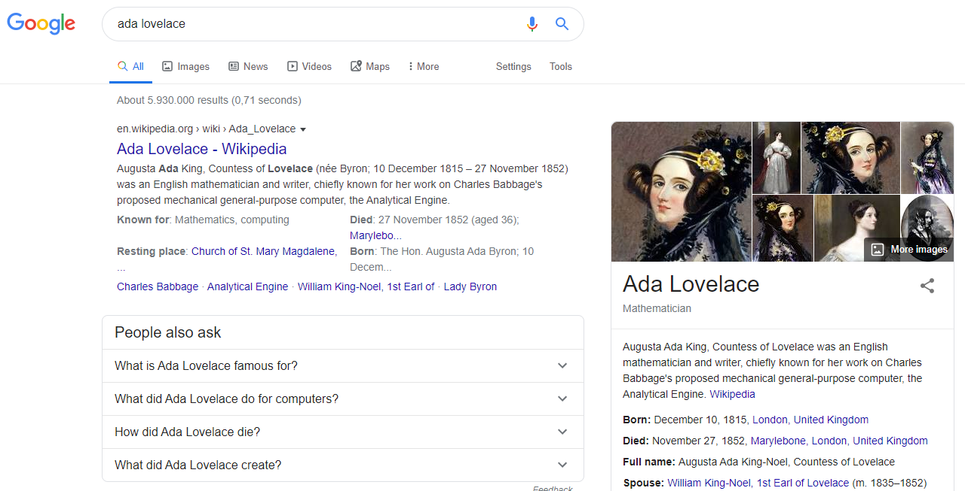

Slide 7
State of research interest
Systemic bias: academically recognized
New Media shift: Gender Gap is being researched in open source & open data

Slide 8
Considerations / Limitations
Most studies conducted in western world
Most studies are user studies
Not enough research on LGBTQ+ within Open Source / Open Data
We thus focused on the gender gap between male & female

Slide 9
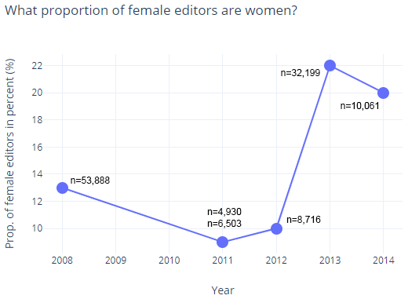
Wikipedia – Female editors
6 studies published 2008-2014 by Wikimedia Foundation
Strongest estimate: 22% of editors are women
Positive trend since 2011

Slide 10
Wikipedia – Self-perception
Helgeson et al.: difference between male & female self-perception & confidence
Why? Societal? Experiences?
Needs further research
Hinnosaar et al.: gender gap due to difference in self-perception
Because of Wikipedia or rather external influence?
Needs further research

Slide 11
Wikipedia – Conflicts with contributions
Lam et al:
Female newcomer-editors more likely to quit Wikipedia after their edits get reverted
Articles with females dominating the edits are significantly more often subject to heated debates
Conflicts → discomfort → demotivation → quitting

Slide 12
Wikipedia – Notability criteria
Wagner et al.: acceptance criteria often unfavorable towards women
Klein et al.: situation is getting considerably better
World is changing & it is reflected in Wikipedia

Slide 13
How to combat the gender gap on Wikipedia? WE SUGGEST
Be careful when reviewing edits of newcomers
Emphasize this in Wiki-guidelines
Thank users for their contributions → strengthen self-esteem
Encourage participation through female-focused info events

Slide 14
Female Participation in Computer Science
Source: Master, Allison & Cheryan, Sapna & Meltzoff, Andrew. (2016). Computing Whether She Belongs: Stereotypes Undermine Girls' Interest and Sense of Belonging in Computer Science. Journal of Educational Psychology. 108. 10.1037/edu0000061.
Notes:
Odd; some women pioneers in the CS field (Ada Lovelace, Grace Hopper)
Describe the contributions to absence of female participation

Slide 15
Stereotypes
Examples: male-dominated, brilliant, nerdy, lack social-skills
Media portrays computer scientists in a stereotypical manner
Hypothesis: Women don‘t consider Computer Science careers because of stereotypes
Stereotypes in childhood with occupation choice
Notes:
Experiment: performed introductionary CS lessons in classroom without stereotypical decoration -> women were more interested in further pursing the field
Decoration gave them the feeling they didn‘t belong there

Slide 16
Social Barrier
Personal
Hesitation in beginning a career in masculine field
Work-family balance?
Under-estimation
Put at disadvantage for displaying expertise
Outside
People lack understanding of the field
Don‘t recommend because it‘s perceived more appropriate for men
More likely to pursue CS when family supports it

Slide 17
Role Models
Lack of female role models nowadays
Richest and most influential computer scientists usually men

Slide 18
Exposure to Computers
Financial situation
High-poverty school → little access to computers
Gender
Difference in use of computers
Boys more likely to have access to computers
First experience with computers because of video games
Boys more likely to use computer for coding
Girls start using computer later
Notes:
Video games tailored to boys

Slide 19
Women in FLOSS
Women make first contributions later in life
2010-2013
39% new female contributors
19% new male contributors
Women code less
Notes:
Men -> start of university; Women -> pursue a career
Men -> source code contributions; women: documentation, testing, translations, etc.

